Slide 1
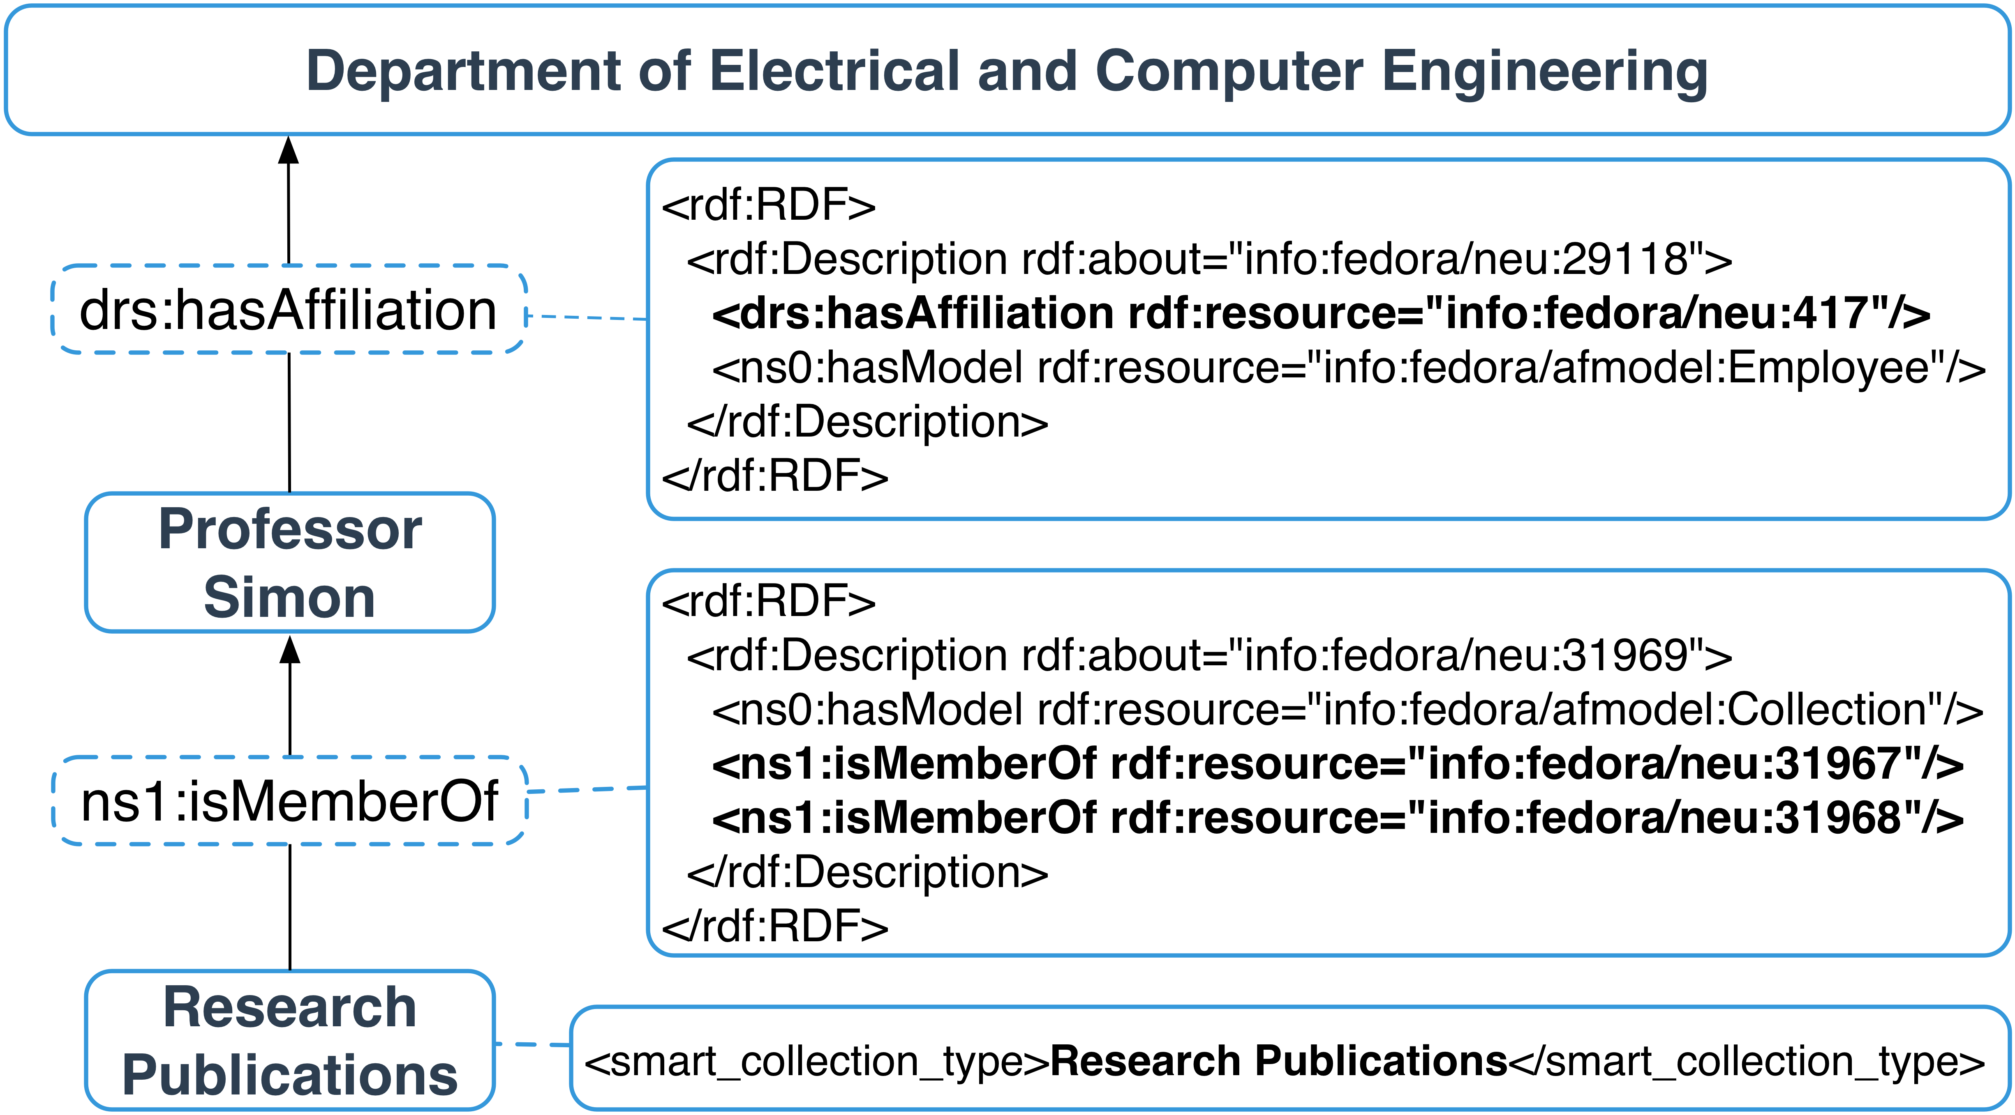
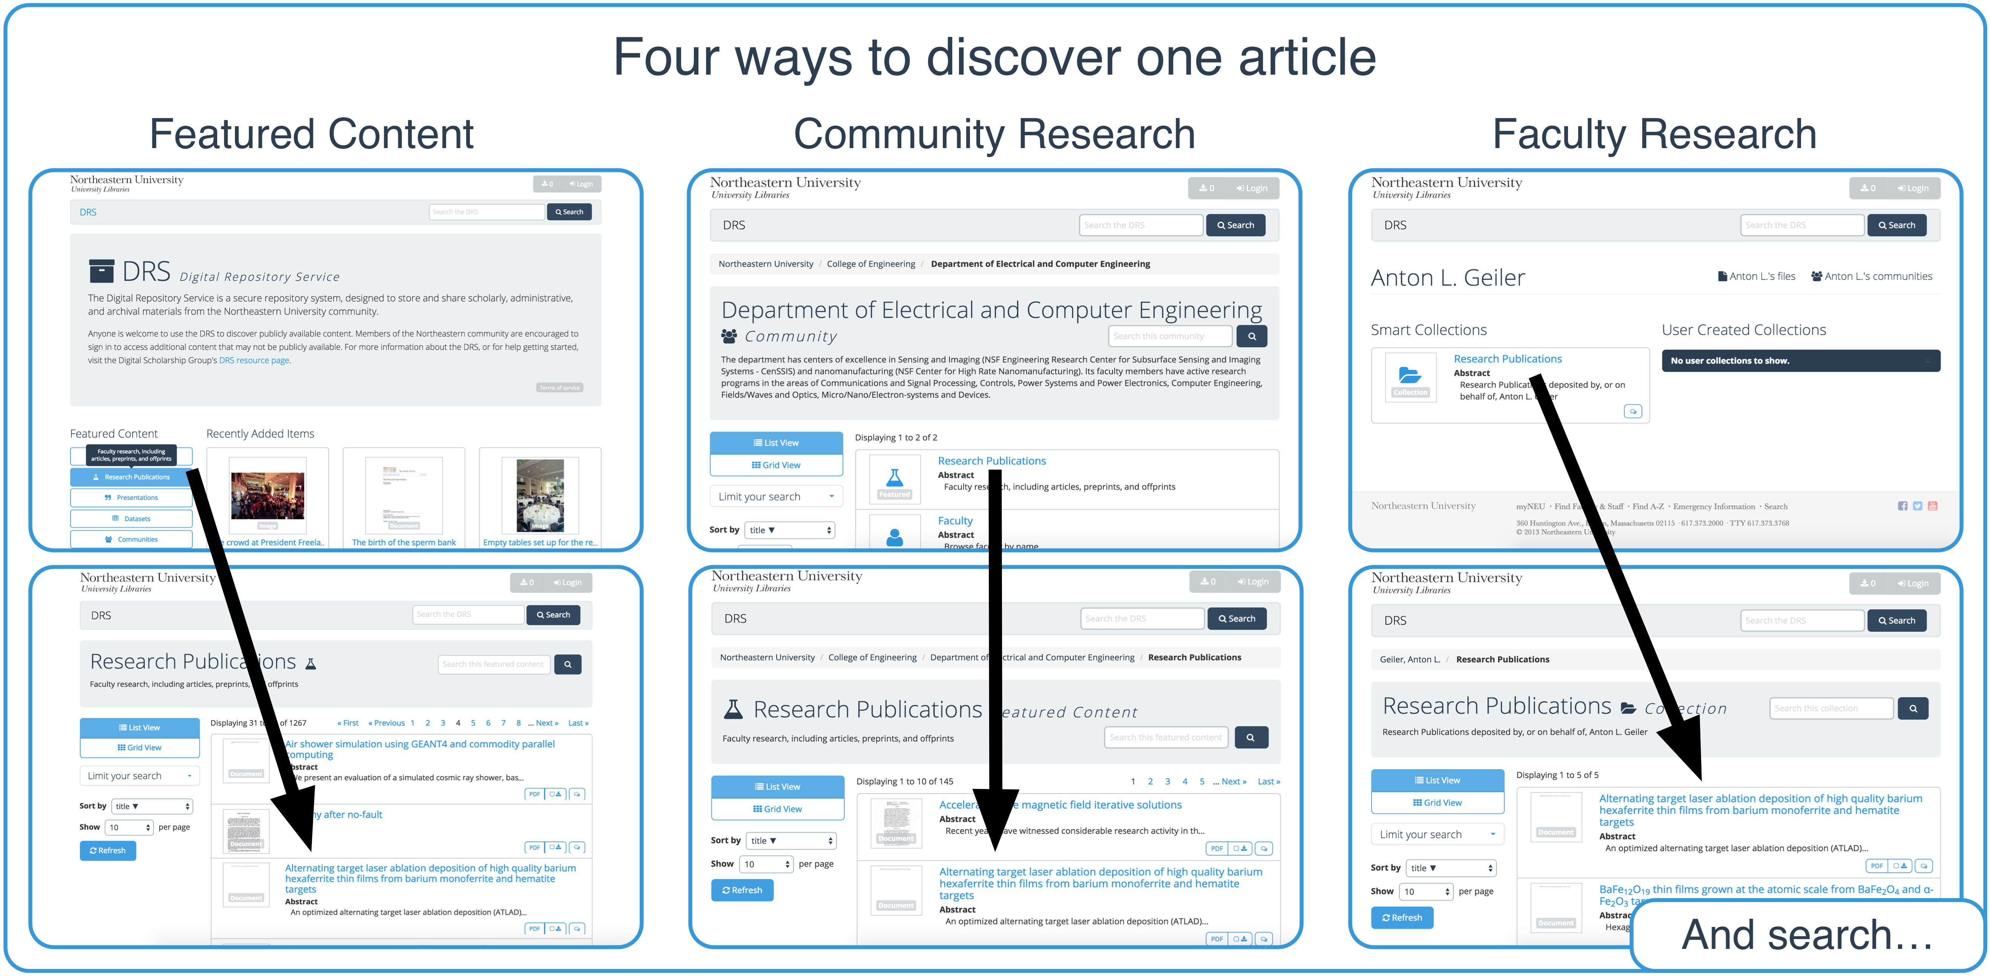

Using Communities to Highlight Scholarly Content in Hydra
Northeastern University Library
Sarah Sweeney sj.sweeney@neu.edu repository.library.northeastern.edu
The DRS Community Structure
The Digital Repository Service (DRS) was designed to store the important scholarly, administrative, and archival assets created as part of Northeastern University's mission. Early on in the development of the DRS we recognized a need to highlight the scholarly content, primarily research publications, presentations, datasets, and theses and dissertations. In order to isolate the scholarly content stored in faculty collections, we decided to model the DRS collection structure after the Northeastern community structure and create relationships between the faculty, their scholarly collections, and their respective NU communities, effectively allowing the DRS to query collections for just highlighted scholarly content deposited by faculty.
The community structure has not just neatly organized repository content according to the existing Northeastern structure, it has made it easier for the system to leverage the relationships between objects to enhance the discoverability of scholarly content in the repository.
Making the Connection
The DRS uses the relationships between faculty users, smart collections, and communities to aggregate content stored in Smart Collections up through the community structure:
Faculty Smart Collections are directly connected to the user with Fedora's predefined <ns1:isMemberOf> statement.
The Hydra properties datastream defines the type of smart collection.
Faculty are connected to communities through the DRS admin panel, which creates a locally defined <drs:hasAffiliation> RDF statement in the RELS-EXT.
Communities & Smart Collections
The DRS uses three types of collections to support the community hierarchy:
Community: A collection that belong to the DRS canonical graph. Communities can only contain communities, collections, or faculty users - no files.
Smart Collection: A collection that belongs to a faculty user that is shared with the user's community.
Ordinary Collection: A typical cluster of files.
The top-level Northeastern community contains communities that represent each school or administrative unit, and nested within these communities are departments and research group communities.
Faculty users are connected to communities, allowing files stored in Smart Collections to be dynamically connected to the community hierarchy.
Homepage Featured Content and community collections that serve up the faculty users' scholarly content are not really collections; they are aggregations of the content stored in faculty smart collections
Advantages
Communities and collections are easily organized according to an existing authoritative framework.
The repository structure follows a model that is quickly understood by Northeastern users.
Valuable repository content can be discovered through multiple search and browse options.
Disadvantages
The repository structure must be actively maintained as the university evolves.
User education is needed for Smart Collections to be effective.
Learn More
For more information about DRS visit dsg.neu.edu/resources/drs or github.com/NEU-Libraries/cerberus
Notes:
Poster

